Slide 1
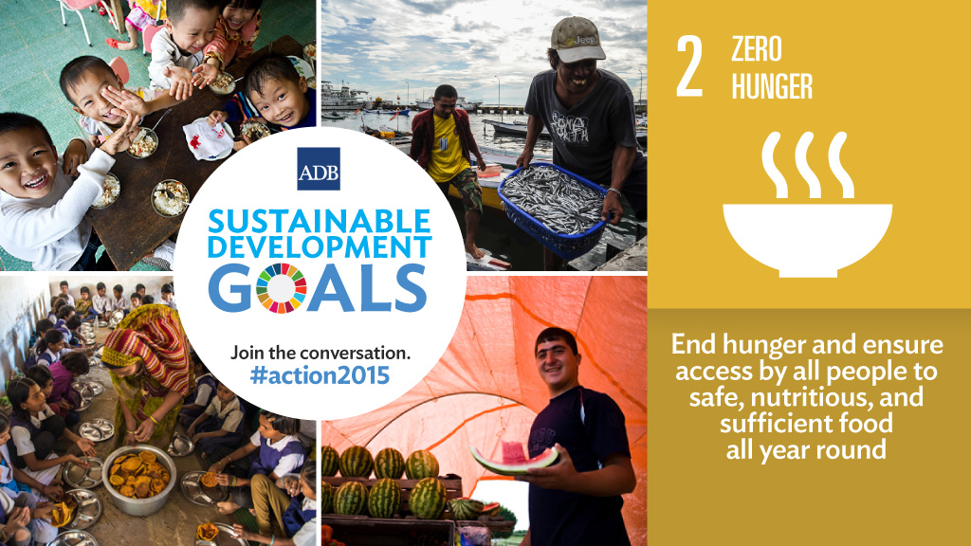
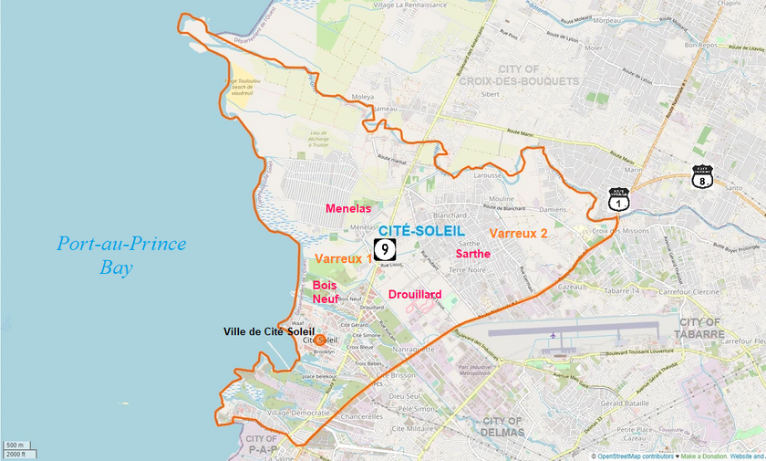
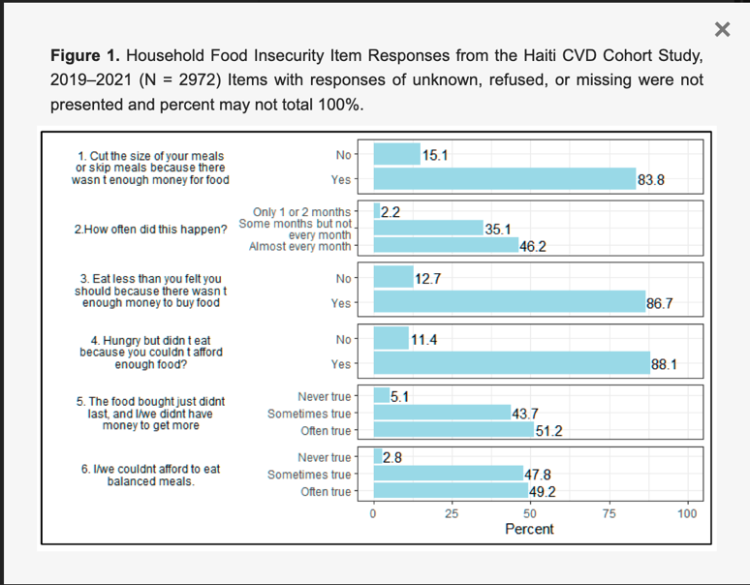
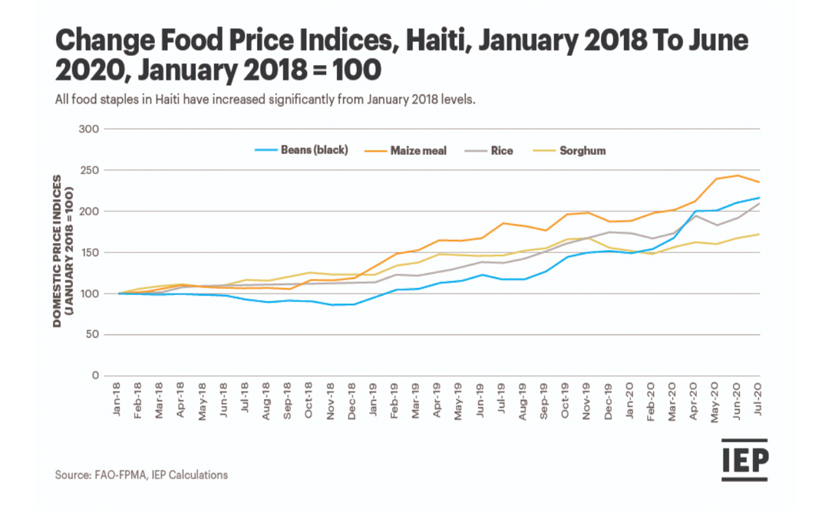
Food Insecurity and Accessibility in Cite Soleil, Haiti
Madison Mitchell
Environmental Science
Senior Seminar
GEOL/GEOG 4830
Abstract
UN Sustainable Development Goals
Methods & Findings
Food insecurity can manifest from a combination of multiple factors. It’s important to emphasize that Cite, Soleil, Haiti is an extremely low-income urban area. The UN Sustainable Development goals allow us to address a wide range of global issues and environmental challenges. The purpose of this research is to determine and understand the primary factors limiting food access and availability in Cite, Soliel Haiti, and it’s impacts. With food insecurity being the city’s largest challenge, the population faces, it leads to the second goals of the UNSDG “Zero Hunger”. According to data literature, being able to actually afford healthy foods plays a major role too, as the population may not be receiving the proper amount nourishment they may need, which leads to hunger. Using a data literature approach allows opportunities to really analyze and synthesize the data and findings for hunger in Cite, Soliel Haiti. Throughout the research findings, other questions could possibly arise that can manifest into other needed research for food insecurity. Examples such as a deeper knowledge and awareness for food insecurity around the globe in other regions and environments, education on the quantitative and qualitative data analysis for data related to food insecurity, data on stakeholder involvement, etc. Food insecurity is a very complex issue, that crosses multiple fields at once. A need for an interdisciplinary approach is critical.
According to the data literature researched, Haiti’s food crisis today continues to have harmful impacts on the community due to key factors such as political instability, natural disasters, and economic challenges. The government and political industry are at a downfall due to challenges such as insufficient and adequate home and building infrastructure, and economic fragility, contribute to food insecurity. Also, limited resources and weak governance hinder the development of effective agricultural and social support systems, amplifying the impact on food availability and accessibility. Haiti’s government has faced challenges with stability, and its economic vulnerabilities contribute to the complexities. Haiti’s agriculture faces challenges such as soil erosion and deforestation, but efforts are underway to promote sustainable practices and improve crop yield. Research shows that Haitian farmers often struggle with limited resources, access to credit, and vulnerability to natural disasters. Initiatives focusing on training, technology, and community support aim to alleviate these challenges. Natural disasters such as earthquakes and hurricanes can devastate crops, disrupt food chain supplies, and worsen food insecurity. Rebuilding efforts often include strategies for more resilient agricultural practices to mitigate future risks. The COVID-19 impact has exacerbated food insecurity in Haiti by disrupting markets, hindering agricultural activities, and affecting livelihoods. Lockdowns and economic challenges have intensified existing vulnerabilities, highlighting the need for comprehensive strategies to address both health and food related crisis. Research suggests that a combination of improved agricultural practices, social safety nets, and education programs can alleviate food insecurity. Implementing sustainable farming methods and fostering community-based initiatives are key components. Initiatives such as urban agriculture projects, community kitchens, and partnerships with NGOs aim to improve access to nutritious food. Local engagement and sustainable solutions are vital for long-term impact.
The UN Sustainable Development Goal 2 (SDG 2) is a goal to “End hunger, achieve food security and improved nutrition, and promote sustainable agriculture.” The focus is on addressing global food insecurity and improving access to nutritious food for all. To achieve the goal, several specific targets were established and listed by the UN to track the process and meet the goal. Below are just a few that relate to Haiti’s specific issues.
Target 2.1: By 2030, end hunger and ensure access by all people in particular, the poor and people in vulnerable situations, including infants, to safe, nutritious, and sufficient food all year round.
Target 2.3: By 20230, double the agricultural productivity and incomes of small-scale food producers, in particular women, indigenous peoples, family farmers, pastoralists, and fishers, including through secure and equal access to land, other productive resources and inputs, knowledge, financial services, markets, and opportunities for value addition and non-farm employment.
Target 2.4: By 2030, ensure sustainable food production systems and implement resilient agricultural practices that increase productivity and production, that help maintain ecosystems, that strengthen capacity for adaption to climate change, extreme weather, drought, flooding, and other disasters, and that progressively improve land and soil quality.
These targets emphasize the need to end hunger, improve nutrition, promote sustainable agriculture, empower small-scale food producers and address issues related to climate change and the sustainable use of resources. Achieving these targets is critical for ensuring that people worldwide have access to safe, nutritious food and can lead healthy lives while promoting environmental sustainability.
Study Objectives
Recommendations
What are the primary factors that are limiting adequate food resources and food access in Haiti? The Zero Hunger Goal 2 is not only a matter of addressing immediate hunger, but also creating a food system that is also sustainable and creative. It crosses an enormous amount of fields, and the impacts connect to many different industries such as policy, climate change, and the COVID-19 impact. Governmental regulations play a key role in food access for Haiti due to the poor economy and high inflation taxes on food imports. Most of Cite, Soliel, Haiti’s population live below the poverty line leading to a limited amount of other outside resources for food insecurity. According to UN News, “Half of the population, 4.9 million people are now struggling to access food according to the new Integrated Food Security Phase Classification analysis. Eight out of ten Haitians are currently spending less on meals, and the country is among the top ten most affected by food price inflation, according to the World Bank (UN News, March 2023). Haiti’s economy due to inflation, has a huge impact on Haiti’s agricultural industry which has caused farmers to reduce their sown areas due to the high inflation cost of seeds and fertilizers while violence is at an all-time high. Malnourishment is also compromising the immunity of Haitians, making them vulnerable to diseases like cholera, and other lifelong health issues, including poor cognitive development. Over the past two decades, frequent natural disasters made it nearly impossible for families to grow an adequate amount of food and feed themselves.
Novel research directions for Haiti’s food insecurity can include exploring the impacts of innovative technologies in agriculture, community-driven resilience strategies, or the intersection of climate change and food production. Additionally investigating the role of local culture and knowledge in shaping sustainable solutions could provide unique insights for addressing the issue of food insecurity and accessibility. Innovative technology is crucial for Haiti’s food insecurity as it can enhance agriculture productivity, improve resource management, and strengthen resilience to environmental challenges. Technologies such as precision farming, mobile apps for market information, and climate resilient crop varieties can empower farmers and contribute to sustainable solutions for food production in Haiti.
Study Area
Summary
Haiti faces food insecurity due to challenges in agriculture, compounded by natural disasters, limited resources, and economic factors. Accessibility issues further strain the situation. Research suggests that a need for sustainable practices, resilient infrastructure, and targeted support for farmers to enhance food security. Addressing Haiti’s food insecurity requires an interdisciplinary approach, including sustainable agricultural practices, improved infrastructure, and access to credit for famers. International collaboration and investments from stakeholders and other organizations or private sectors play a crucial role in ensuring long-term food security.
13.A Implement the commitment undertaken by developed-country parties to the United Nations Framework Convention on Climate Change to a goal of mobilizing jointly $100 billion annually by 2020 from all sources to address the needs of developing countries in the context of meaningful mitigation actions and transparency on implementation and fully operationalize the Green Climate Fund through its capitalization as soon as possible
13.B Promote mechanisms for raising capacity for effective climate change-related planning and management in least developed countries and small island developing States, including focusing on women, youth and local and marginalized communities
Literature Cited
Reflections
Haiti Emergency Food Security Assessment, Haitian National Coordination for Food Security and World Food Programme, Dec. 2015.
Dlewis. “Crisis in Haiti Intensifies amid Covid-19 Pandemic: ETR 2020 Report.” Vision of Humanity, 3 June 2022, www.visionofhumanity.org/etr-2020-the-pandemics-toll-on-food-insecurity-and-undernourishment-in-haiti/.
Rasul, R., Rouzier, V., Sufra, R., Yan, L. D., Joseph, I., Mourra, N., Sabwa, S., Deschamps, M. M., Fitzgerald, D. W., Pape, J. W., Nash, D., & McNairy, M. L. (2022, November 17). Extreme food insecurity and malnutrition in Haiti: Findings from a population-based cohort in Port-au-Prince, Haiti. MDPI. https://www.mdpi.com/2072-6643/14/22/4854
One in five children suffers from acute malnutrition in Cité Soleil. UNICEF. (2022, October 14). https://www.unicef.org/haiti/en/stories/one-five-children-suffers-acute-malnutrition-cit%C3%A9-soleil#:~:text=A%20nutrition%20assessment%20conducted%20in,nearly%20one%20in%20four%20children.
Researching about Haiti’s food crisis was very interesting and taught that sustainability is important throughout all aspects of life, rather that be agricultural practices, food, building infrastructure, etc. Sustainability is needed for the livelihood of others. The economic and governmental conditions play a huge role in a thriving country. Haiti’s food crisis reflects a complex interplay of political, economic, and environmental challenges. Insufficient infrastructure, political instability, and susceptibility to natural disasters intensify the struggle of food security. Addressing these issues requires not only immediate relief efforts but also sustained focus on long-term solutions for resilience and sustainable development.

